Slide 1

Secure File Storage on Cloud Using Hybrid Cryptography
By
Vaibhav Bharti Roll no. 2013623
Vaibhav joshi roll no. 2013566
Mukul sharma roll no. 2013390

Slide 2
Topics
Background
Technology Used
Algorithm used
Working & Functioning of the project
Uses
Difficulties Faced
Future Scope

Slide 3

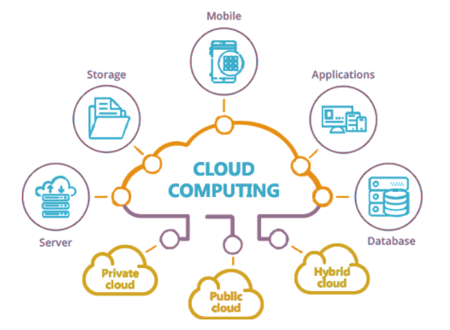



What is Cloud? What is Cloud Computing Benefits of Cloud Computing?

Slide 4
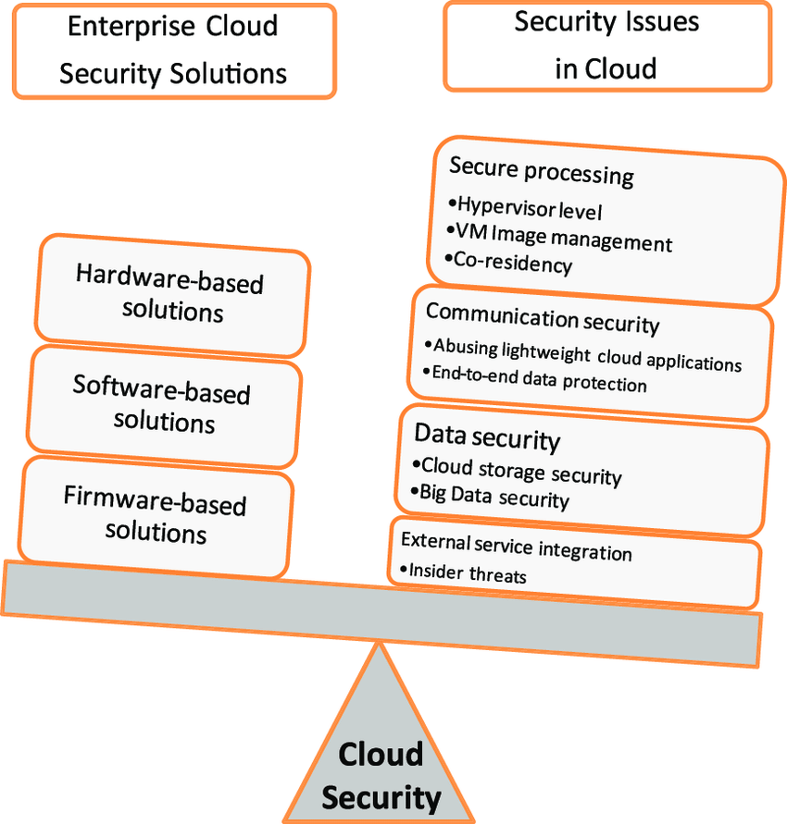
Limitations of cloud and Threats to data security
Risk of data confidentiality
The level of security
Data Mobility

Slide 5

Why this project?

Slide 6

Cryptography Technique

Slide 7
AES
AES is widely adopted.
No practical cryptanalytic attacks against AES.
Built in Flexibility.
Correct implementation.

Slide 8
DES
Two desire property
Avalanche effect
Completeness
Weakness with keys
Well designed block cipher

Slide 9
RC2
Symmetric key block cipher.
64 bit block cipher with variable key size using 18 round.
18 mixing round are performed
perform 5 mixing rounds.
perform 1 mashing round.
perform 6 mixing rounds.
perform 1 mashing round.
perform 5 mixing rounds.

Slide 10

Project Working

Slide 11


Encryption Data
Hi vaibhav, how are you today
Hi vaibhav,
How are
You today
AES
DES
RC2
%$&
*&%^
@#%$
Key

Slide 12
Decryption Data
Key
%$&
@#%$
*&%^
AES
DES
RC2
Hi vaibhav,
How are
You today
Hi vaibhav, how are you today

Slide 13


Uses
z
The file is completely secure as it is encrypted by 3 different algorithms but with hybrid cryptography.
The key is also safe as it embeds the key in image using Least Significant Bit(LSB).
The system is very secure and robust in nature.
Data is kept secured on cloud server which avoids unauthorized access.

Slide 14

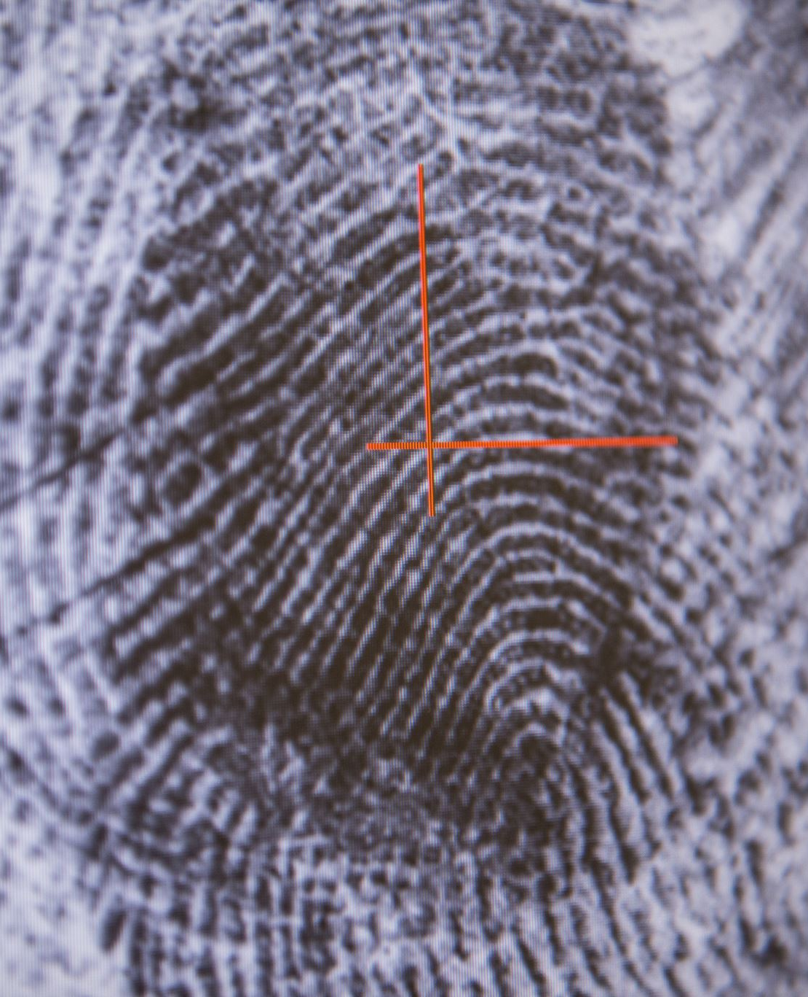
Future Improvements
Applied on pictures and on video files
Fingerprint technology could be used to secure the key

Slide 15
Advantages
The stored image file is completely secured, as the file is being encrypted not by just using one but three encryption algorithm which are AES, DES and RC2.
The key is also safe as it embeds the key in image using LSB.
The system is very secure and robust in nature.
Data is kept secured on cloud server which avoids unauthorized access

Slide 16

Current Project Status
z

Slide 17


